Slide 1
AUTOMATED UI TESTING SUITE FOR ARA ICT DIVISION
DANIEL WILD
BCIS309 – WORK INTEGRATED LEARNING PROJECT, SOFTWARE DEVELOPMENT PATHWAY
Semester 1, 2023

Slide 2

The Client
Ara Institute of Canterbury, a subsidiary Te Pūkenga New Zealand Institute of Skills and Technology.
Ara Institute of Canterbury was formed in 2016 when CPIT and Aoraki Polytechnic merged.
Te Pūkenga was formed in 2023 when all Institutes of Technology and Polytechnics in New Zealand merged.

Slide 3
Project Details and Scope
Background Overview – Process stated by others on different apps, so a framework of materials and a range of example code.
Project Goal(s) - Create automated testing suites for six React web applications using Puppeteer.
Benefits of Project - Direct development to production deployment testing making releases more reliable.

Slide 4
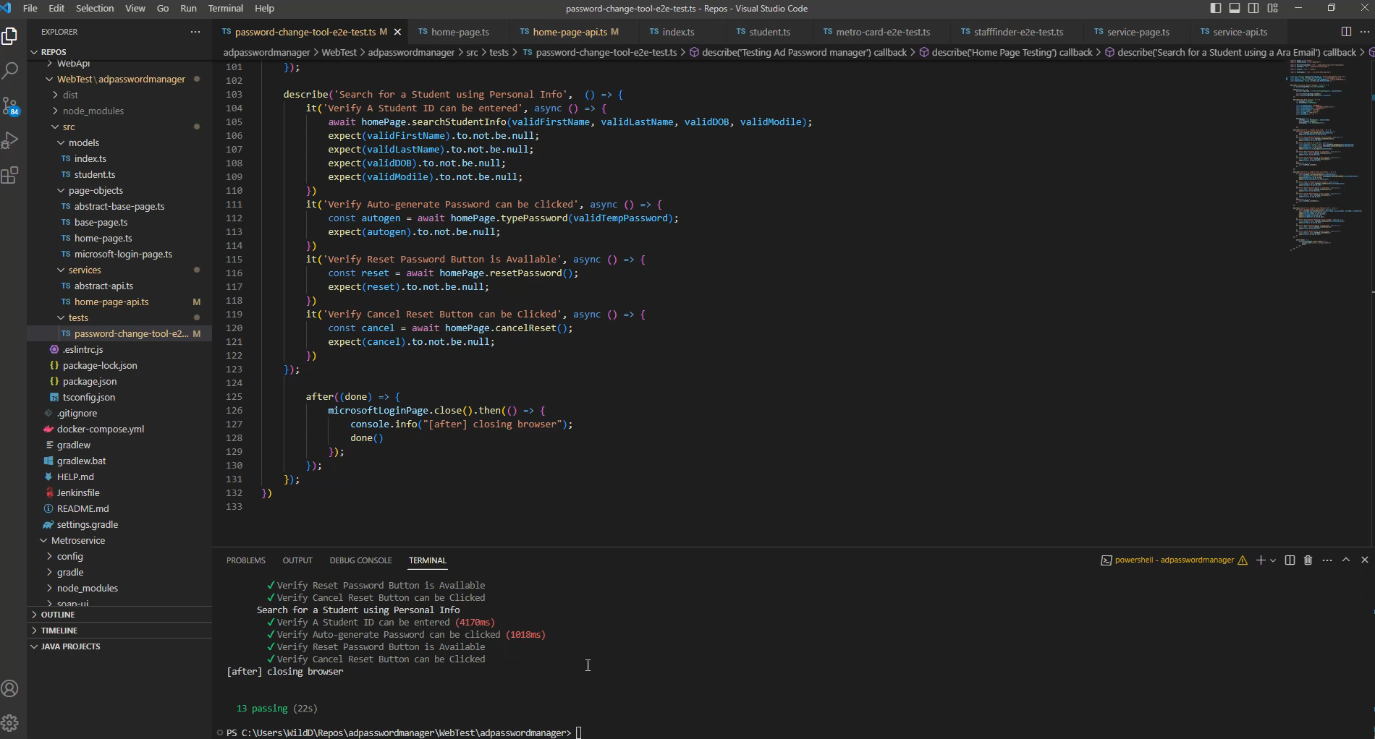
Demo

Slide 5
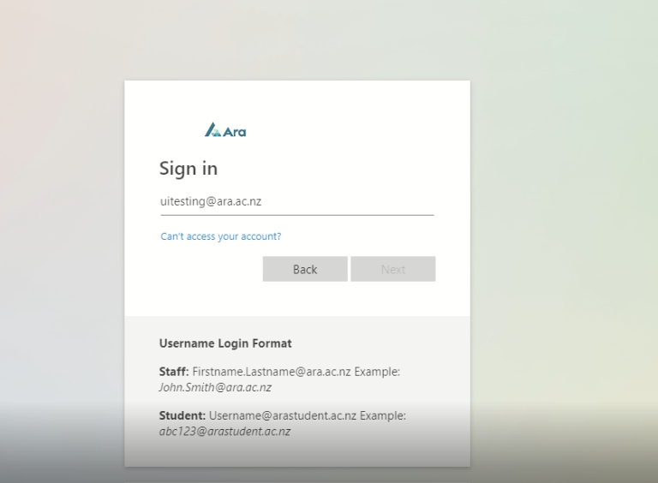
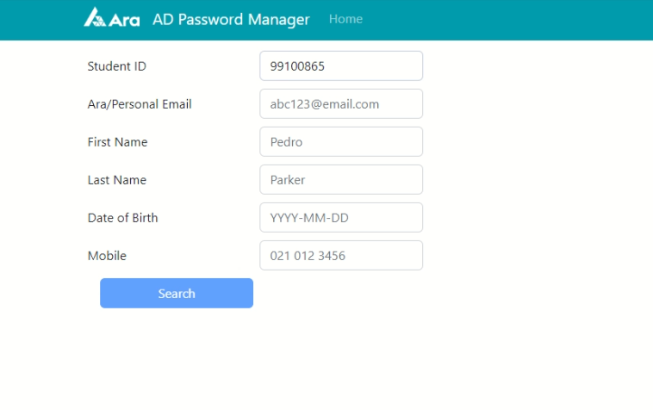
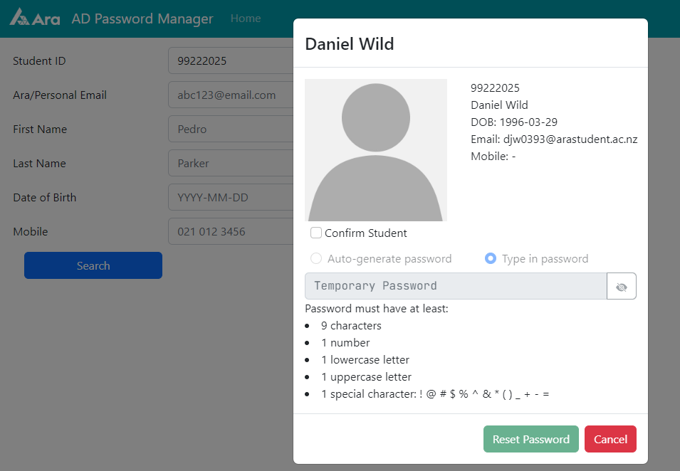
Demo: Explication
Step 1
Step 2
Step 3
Step 4 repeat with other search fields

Slide 6
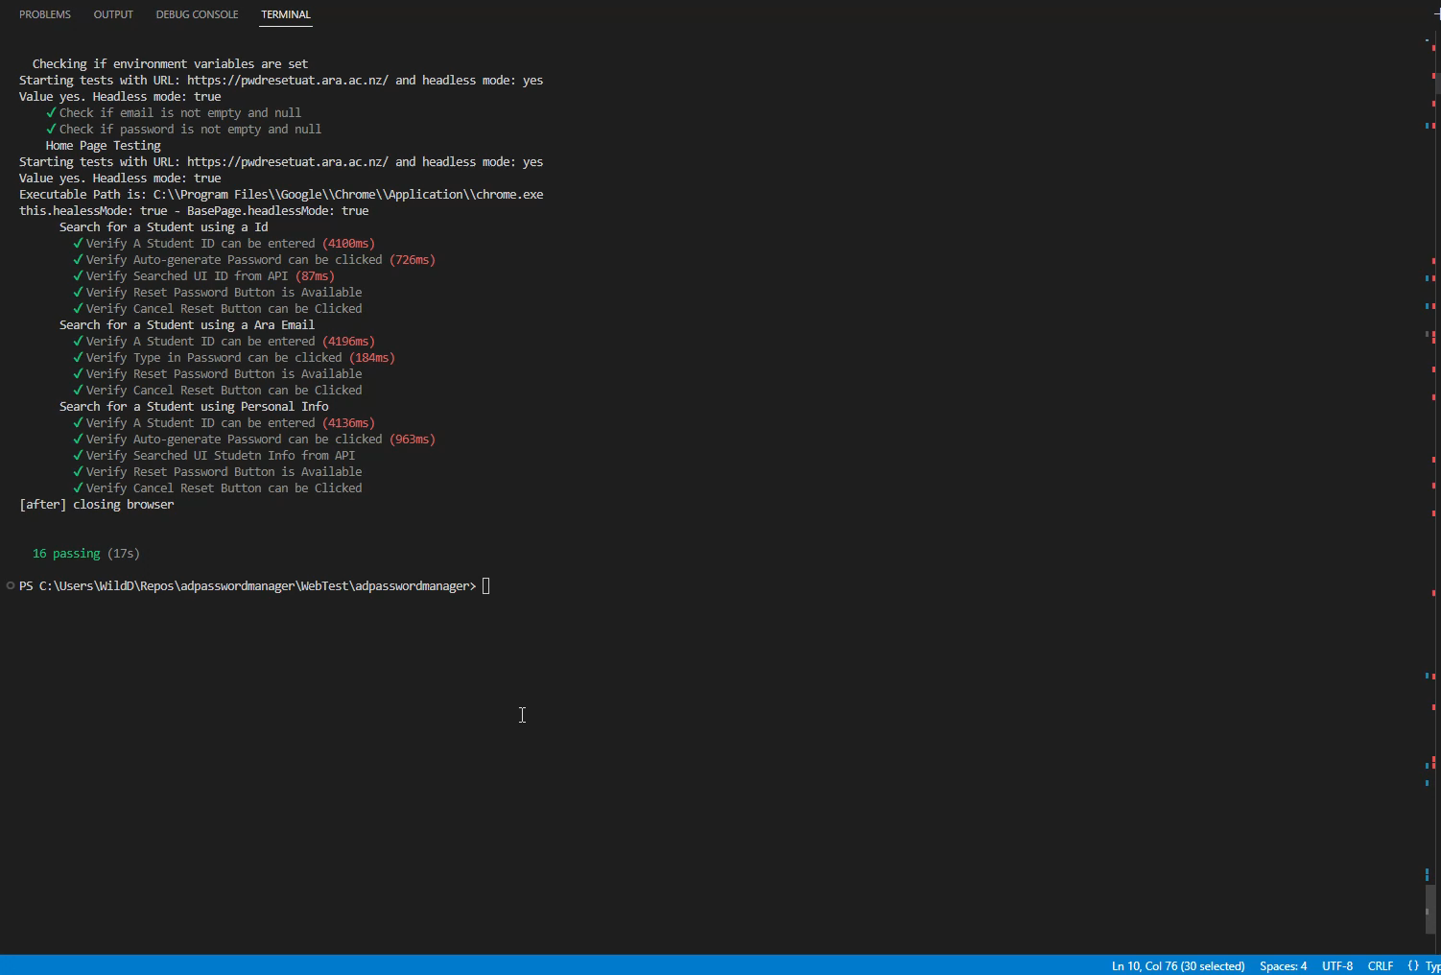
Demo 2

Slide 7
How Project Was Done – Tools: VSCode, Puppeteer Typescript and XPATH

Slide 8
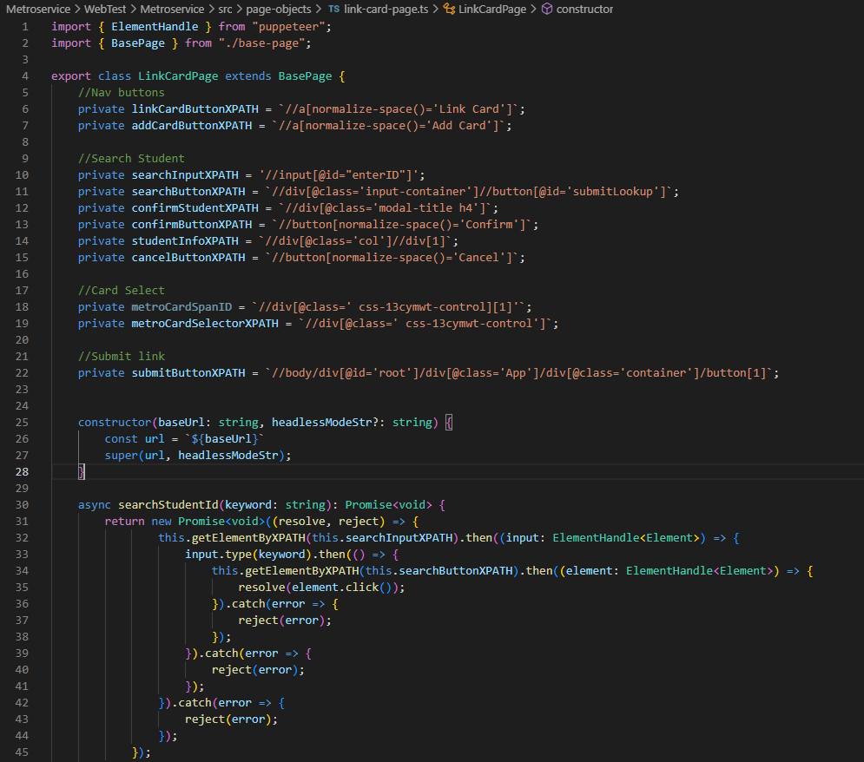
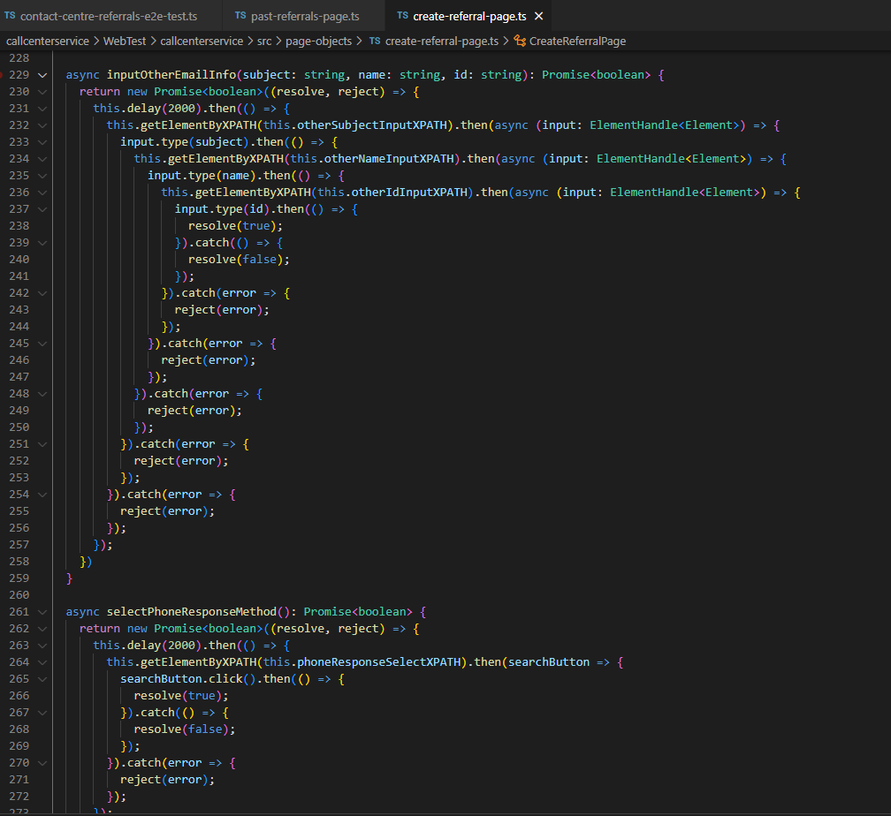
Testing Skills from BICT to Now
Before
After

Slide 9
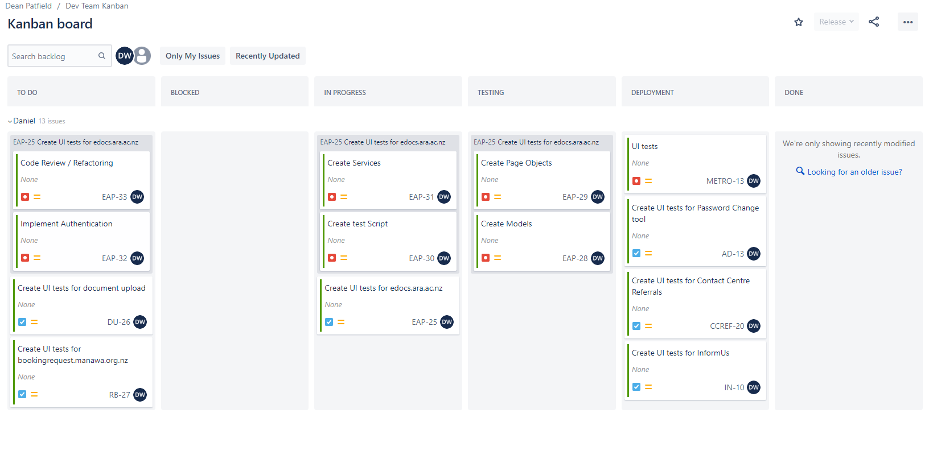
How Project Was Done – Methodology: Kanban

Slide 10
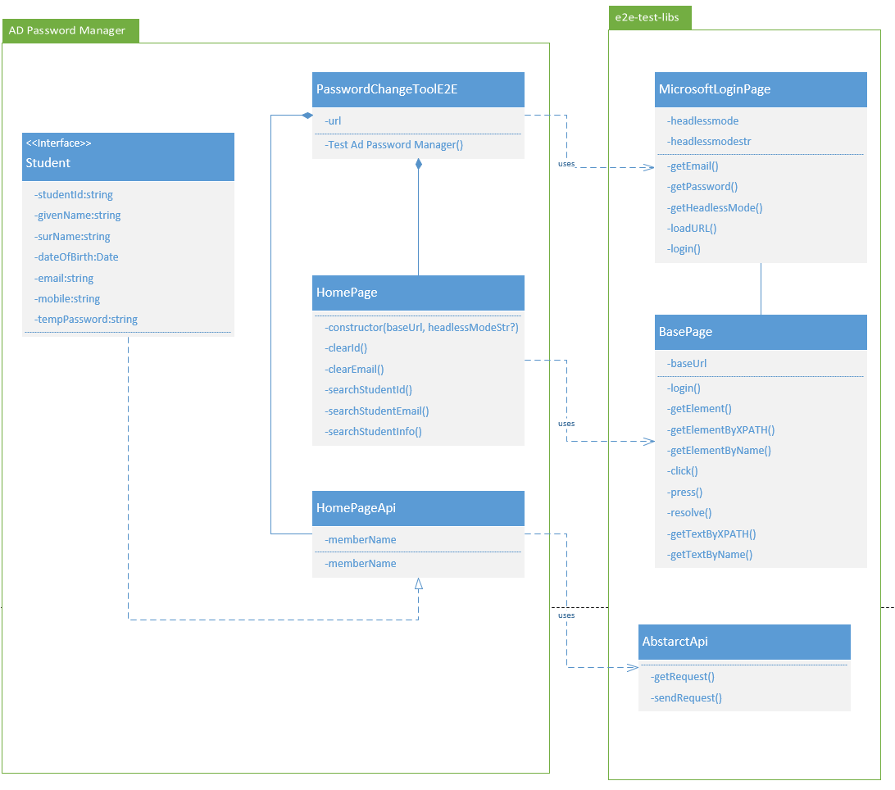
What is Next for the Project
More apps tested
Changes to the way the base page functions

Slide 11
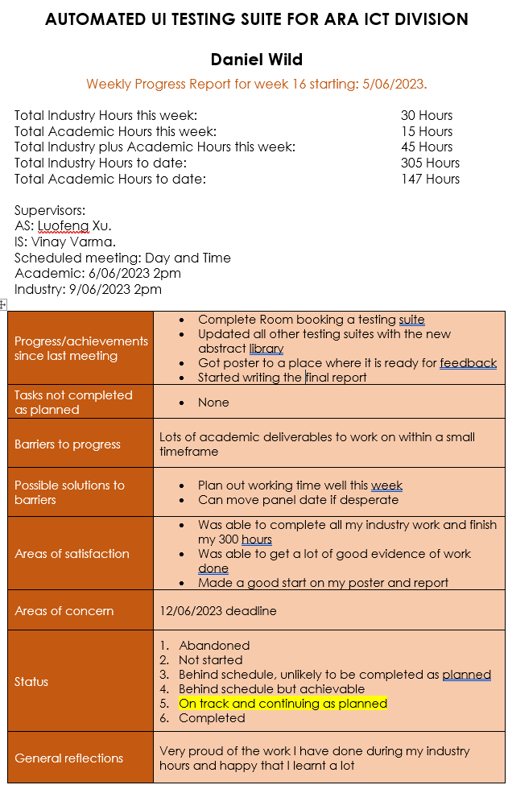
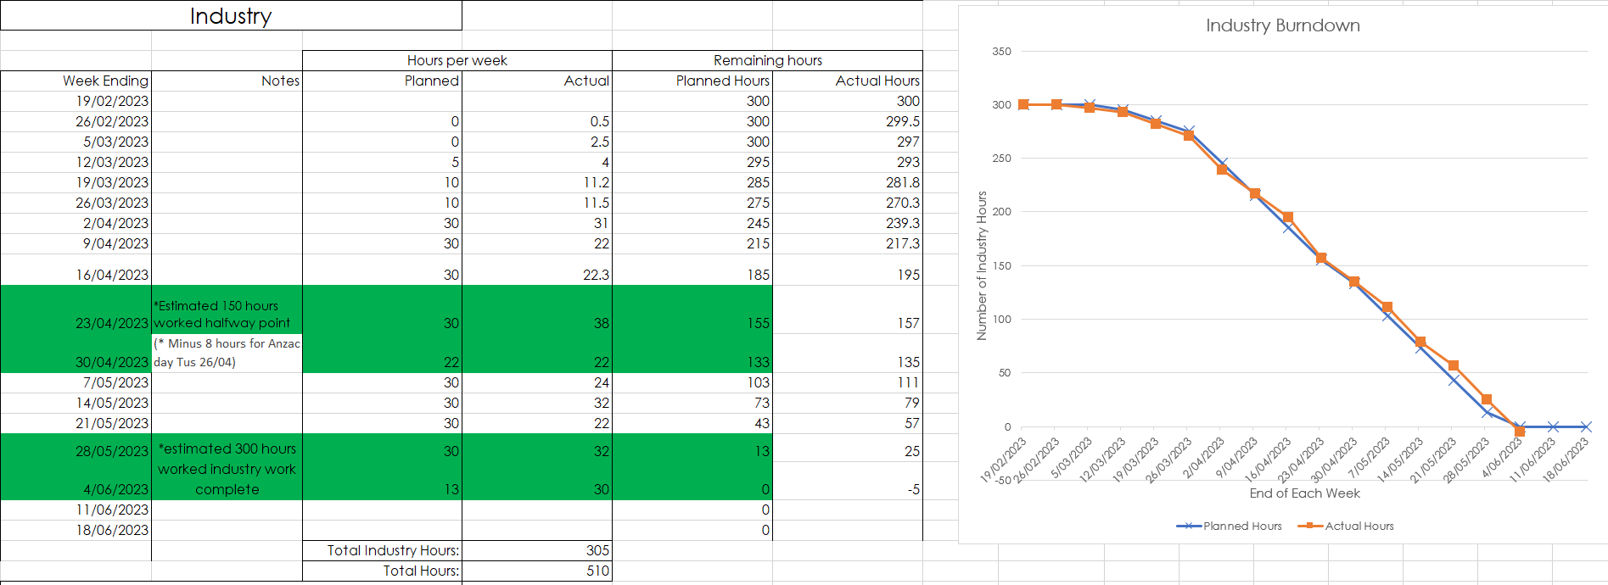
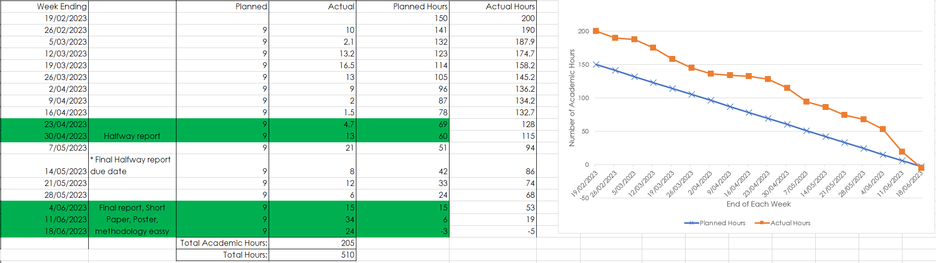
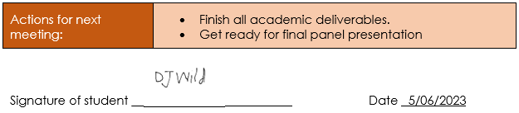
Course Management

Slide 12
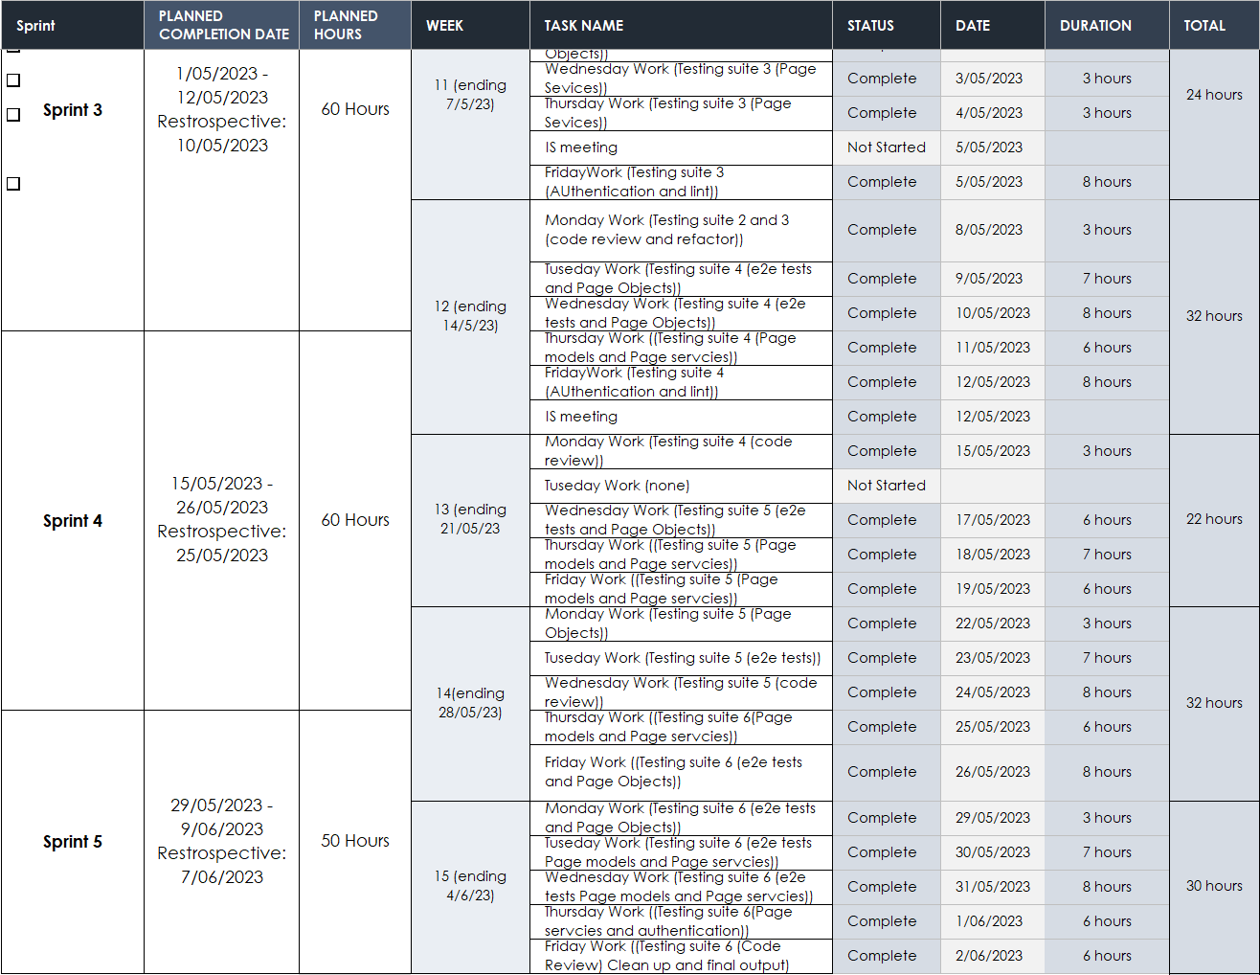
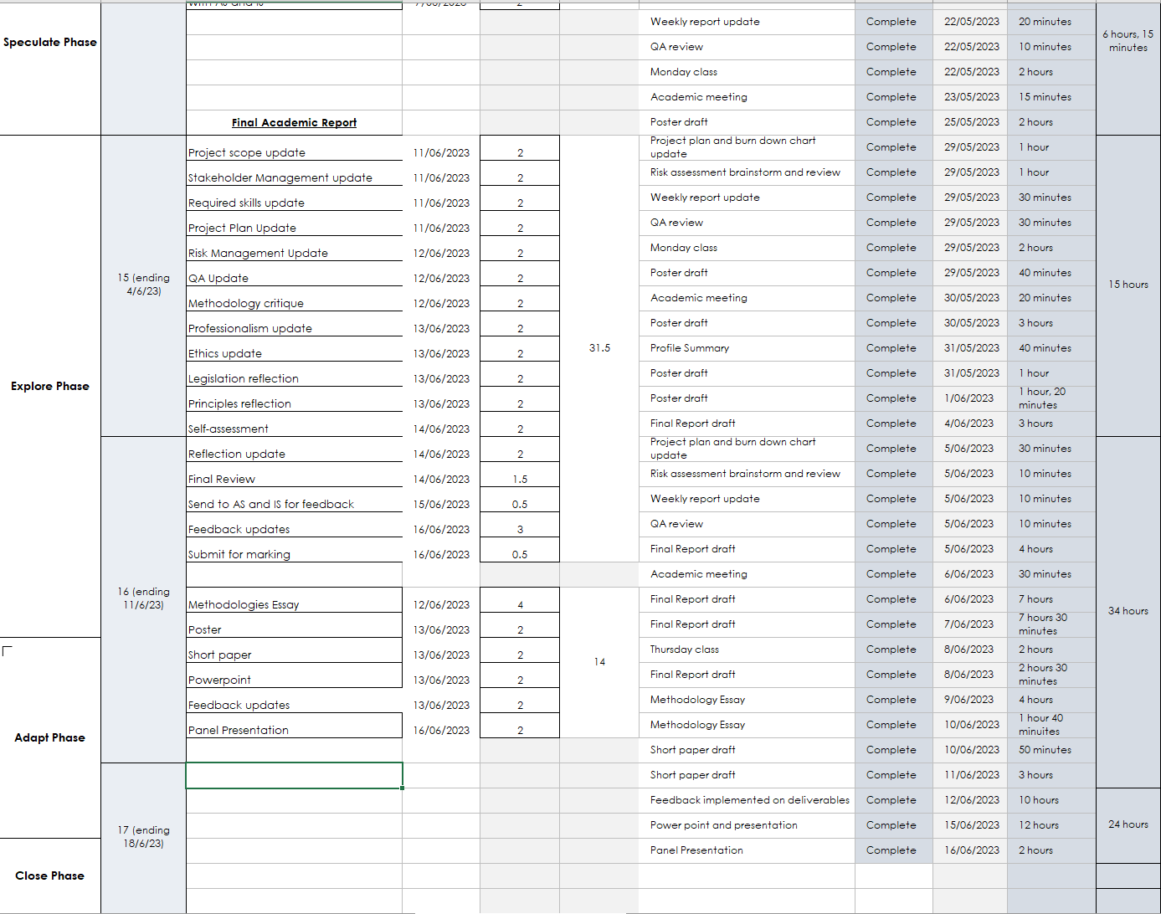
Course Management
Industry
Academic

Slide 13
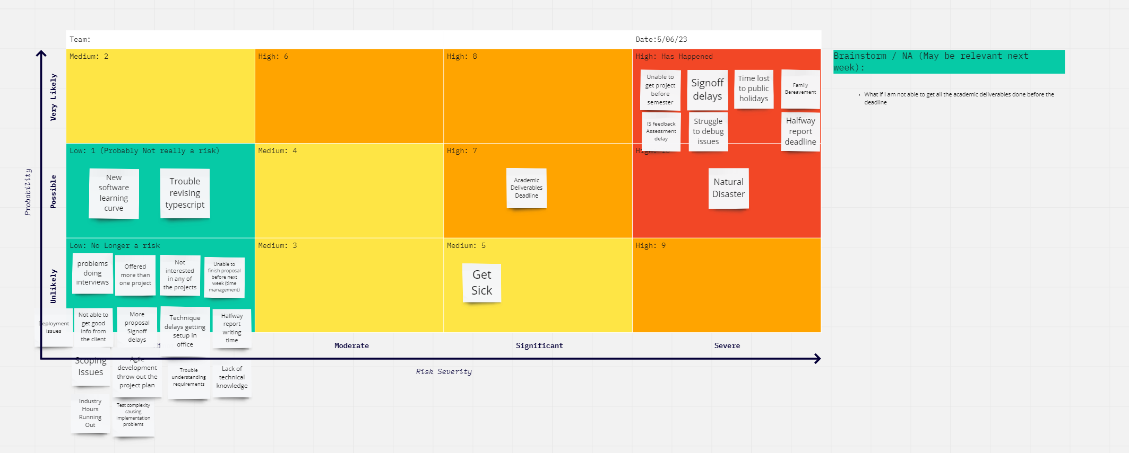
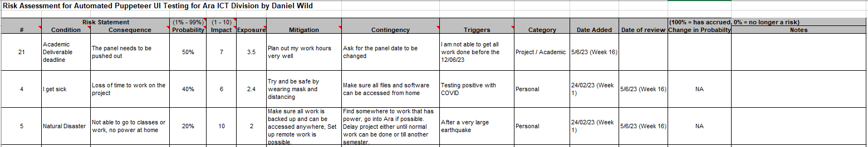
Risk

Slide 14
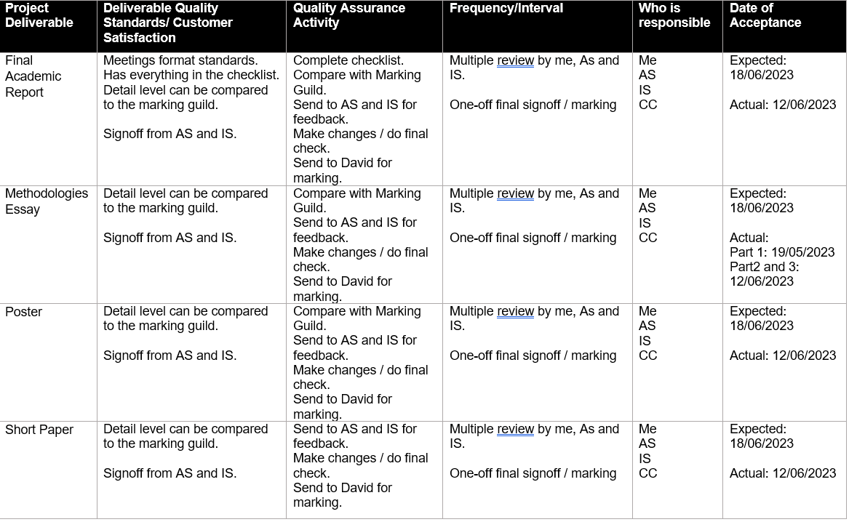
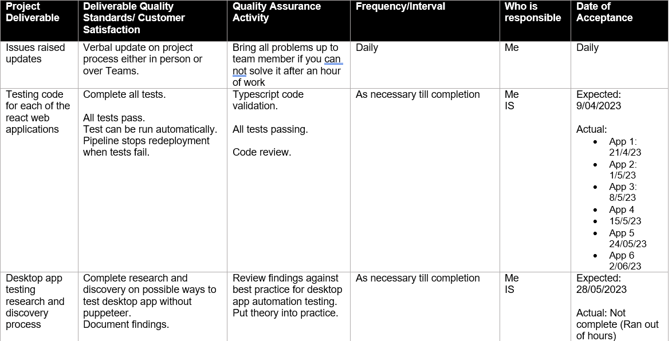
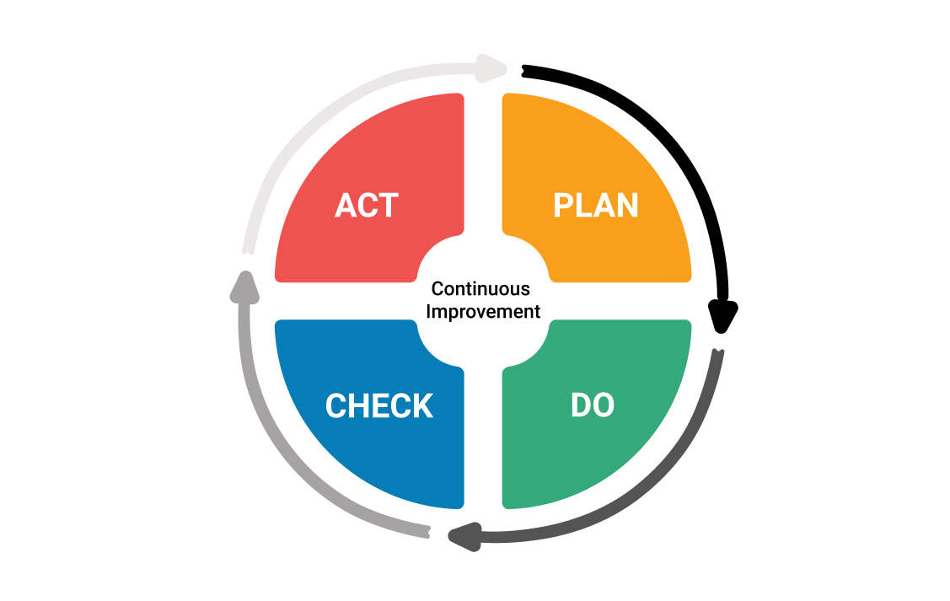
Quality Assurance
Academic
Industry

Slide 15
Lessons Learnt
Time Management
Version Control
Debugging and Work Priority

Slide 16
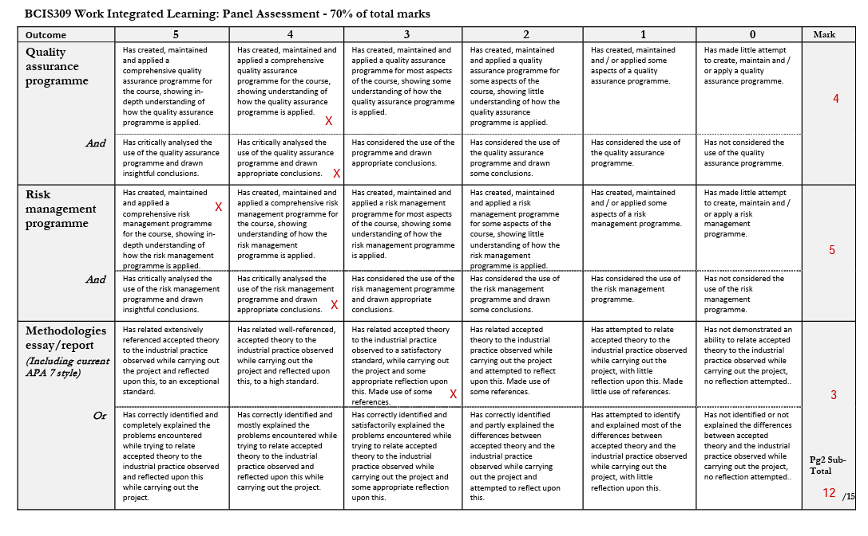
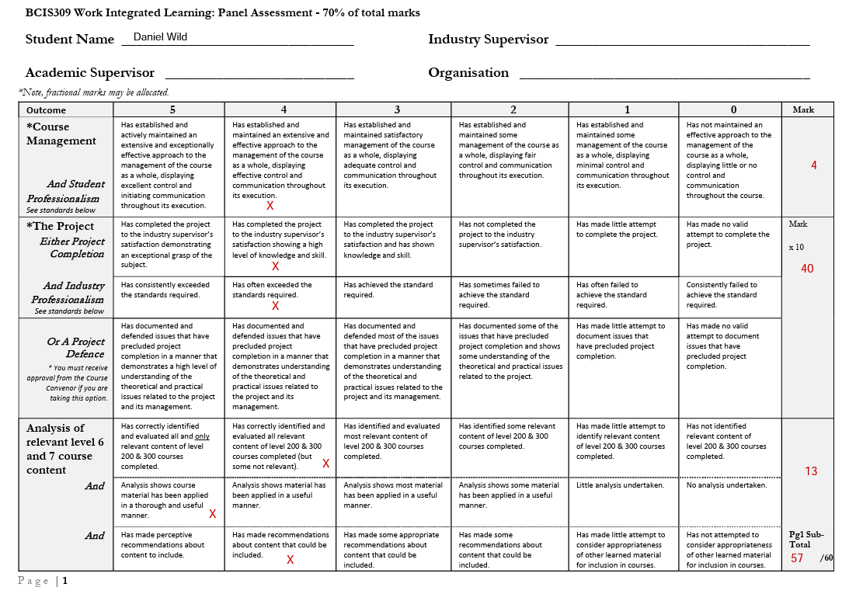
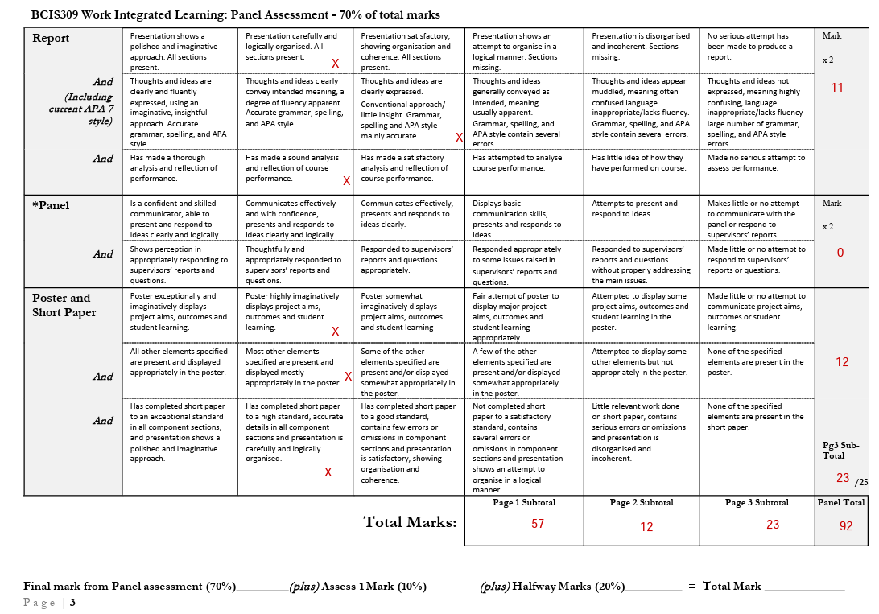
Self-Assessment

Slide 17
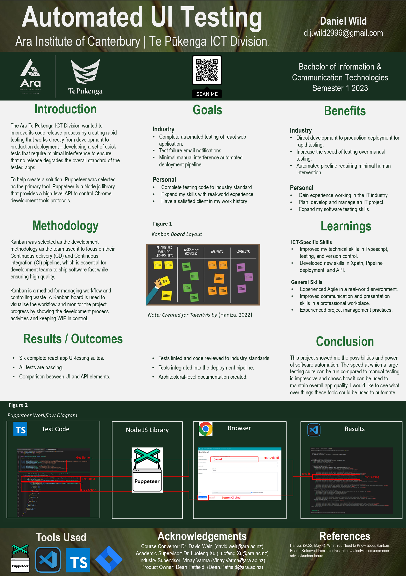
Poster

